Slide 1
VCG: a General Purpose Library for Simplicial Complexes
  Visual Computing Laboratory
  ISTI – CNR
  Pisa

Slide 2
VCG: the goals
A framework to implement algorithms on Simplicial Complexes of order d=0..3 in R^n:
  Efficient code
  Easy to understand
  Flexible
  Reusable
  Multiplatform (MS 7.1,Intel,gnu)
  Open Source: http://vcg.sourceforge.org

Slide 3
VCG Structure
root
The library: definitions and algorithms.
Only standard c++ e STL here.
Entirely self-contained. No inclusion to
external file or linking of other libraries
vcg
Wrapping the library concepts,e.g.:
draw a mesh using opengl....
Trackball/decorators....
file importers/exporters..
wrap
apps
Applications made with the library
docs
Documentation: styleguide and manual generated by Doc++

Slide 4
VCG
vcg
simplex
Definition of simplex (order 0..3)
- Definition of complex
Iterators to walk on the mesh
Local operators (edge split, edge collapse etc..)
Algorithms (simplification, smoothing,
mesh generation..)
complex
container
Specialization of STL vector used to
handle optional attributes of simplices
Basic geometric entities
intersection between geometric entities
- Spatial indexing data structures
space
math
Some linear algebra

Slide 5
Outline
The core of VCG:
  Definition of simplex and complex
  Dynamic attributes
  Surfing the mesh
  Manifoldness
The basic algorithms
  updating algorithms: bounding box, smoothing...
  creation algorithms: refine, platonic
The applications
  Metro, Tridecimator, MeshLab
Comparison with other libraries
  OpenMesh

Slide 6
Simplex
VCG simplices: Vertex,Edge,Face,Tetrahedron
A simplex can have attributes other then its geometrical position:
  normal, color,quality, connectivity information, etc.
One may want:
  To have a vertex with any combination of these attributes
  To choose a set of attributes dynamically
  To create user-defined attributes

Slide 7
Example: Vertex
All the desired attributes are passed as template class to the vertex:
The template parameters can be passed in any order
How? Template list are unrolled in a chain of derivations
typedef VertexSimp1<
Vertex0,
EdgeProto,
vcg::vert::VFAdj,
vcg::vert::Normal3f,
vcg::vert::Color4b> MyVertex;
vcg::vert::EmptyInfo
vcg::vert::EmptyVFAdj
vcg::vert::Color4b
...
vcg::vert::EmptyFlags
vcg::vert::Normal3f
vcg::vert::EmptyInfo
vcg::vert::VFAdj
vcg::vert::EmptyNormal
MyVertex
vcg::vert::EmptyColor

Slide 8
Example: Normal
In the chain Normal is derived by EmptyNormal
The member N() is overridden
  template <class T> class EmptyNormal: public T {
  public:
  typedef vcg::Point3s NormalType;
  NormalType &N() { static NormalType dummy_normal(0, 0, 0); return dummy_normal; }
  static bool HasNormal() { return false; }
  };
  template <class A, class T> class Normal: public T {
  public:
  typedef A NormalType;
  NormalType &N() { return _norm; }
  static return HasNormal() { return true; }
  private:
  NormalType _norm;
  };
  template <class T> class Normal3s: public Normal<vcg::Point3s, T> {};
  template <class T> class Normal3f: public Normal<vcg::Point3f, T> {};
  template <class T> class Normal3d: public Normal<vcg::Point3d, T> {};

Slide 9
Complex (ex: TriMesh)
A complex is a collection of simplices
Only max and min order simplices are kept explicitly
template < class VertContainerType, class FaceContainerType >
class TriMesh{
public:
/// Set of vertices
VertContainer vert;
/// Actual number of vertices
int vn;
/// Set of faces
FaceContainer face;
/// Actual number of faces
int fn;
...
};

Slide 10
Hello Mesh
#include <vcg/simplex/vertexplus/base.h>
#include <vcg/simplex/faceplus/base.h>
#include <vcg/complex/trimesh/base.h>
class MyEdge;
class MyEdge;
class MyVertex: public VertexSimp2<MyVertex,MyEdge,MyFace,vcg::Coord3f>{};
class MyFace : public Face<MyVertex,MyEdge,MyFace,face::VertexRef>{};
class MyMesh : public tri::TriMesh< vector<MyVertex>, vector<MyFace > >{};
The type vertex stores only its position
The type face stores only the pointers to its 3 vertices

Slide 11
Optional attributes
You may want some attributes only temporarily (ex: the normal per vertex)
Examples:
  to load a mesh without wasting space
  to use an algorithm that requires an attribute you don’ t need often
The easy way:
  allocate a vector of normals: the i-th element is the normal of the i-th vertex. Easy but:
    not transparent: algorithms need to be know if the normal is an optional attribute to read/write its value
    Need to keep track of memory relocation of STL containers

Slide 12
Optional attributes
VCG provides 2 alternative ways
  Optional Component Fast [Ocf]
  Optional Component Compact [Occ]
Ocf requires a 4 bytes overhead per vertex, Occ requires a small overhead per mesh
Ocf efficiency is not affected by the number of elements in memory, Occ's is.

Slide 13
Ocf
Include vector_ocf.h
#include <vcg/space/point3.h>
#include <vcg/simplex/vertexplus/base.h>
#include <vcg/simplex/vertexplus/component_ocf.h>
using namespace vcg;
class MyE;
class MyVertex:public VertexSimp2<MyVertex,MyE,vert::InfoOcf,vert::Normal3fOcf>{};
int main(int,char**){
vector_ocf<MyVertex> v;
// put some vertices in the vector
for( i= 0; i < 10; i++) v.push_back(MyVertex());
// activate the attribute
v.EnableNormal();
// put some more vertices in the vector
for( i= 0; i < 10; i++) v.push_back(MyVertex());
v[2].N()=Point3f(1.0,2,3);
// drop the attribute
v.DisableNormal();
}
Add the suffix Ocf to the
class name of the attibute
Add attribute InfoOcf
Store the vertices in a
vector_ocf container

Slide 14
Occ
Include vector_occ.h
and component.h
Add the suffix Occ to the
class name of the attibute
#include <vcg/space/point3.h>
#include <vcg/container/vector_occ.h>
#include <vcg/simplex/vertexplus/base.h>
#include <vcg/simplex/vertexplus/component_occ.h>
using namespace vcg;
class MyE;
class MyVertex: public VertexSimp2< MyVertex,MyE,vcg::vert::Normal3fOcc>{};
int main(int,char**){
vector_occ<MyVertex> v;
// put some vertices in the vector
for( i= 0; i < 10; i++) v.push_back(MyVertex());
// activate the attribute
v.EnableAttribute< MyVertex::NormalType>();
// put some more vertices in the vector
for( i= 0; i < 10; i++) v.push_back(MyVertex());
v[2].N()=Point3f(1.0,2,3);
// drop the attribute
v.DisableAttribute< MyVertex::NormalType >();
}
Stores the vertices in a
vector_occ container

Slide 15
User-defined optional attr.
Only in Occ style
.....
vector_occ<MyVertex> v;
// put some vertices in the vector
for( i= 0; i < 10; i++) v.push_back(MyVertex());
// define a user-defined optional attribute
TempData<vector_occ<MyVertex>,USER_TYPE> handle = v.NewTempData<USER_TYPE>();
// activate the user defined attribute
c2.EnableAttribute< USER_TYPE>();
// put some more vertices in the vector
for( i= 0; i < 10; i++) c1.push_back(MyVertex());
handle[&c1[2]] = USER_TYPE_value;
// drop the attribute
c1.DisableAttribute< USER_TYPE >();
}

Slide 16

ocf/occ implementation
Mesh:
STL vector of NormalOc?
vector_oc? of vertices
v.N()
vector of faces
….
  template <class T> class NormalOcf: public T {
  public:
  typedef vcg::Point3s NormalType;
  NormalType &N() {
  // Need to know the position of (*this) in the // vector
  }
vcg::vert::Normal3fOcf
….

Slide 17
ocf implementation
Mesh:
STL vector of NormalOcf
vector_ocf of vertices
v.N()
vector of faces
….
  Every element of the vector_ocf stores a pointer to the first position of the vector.
  The vector contains one pointer to the first position of every vector of optional attributes.
vcg::vert::Normal3fOcf
….

Slide 18
occ implementation
Container Allocation Table
Mesh:
vector_occ of vertices
STL vector of NormalOcc
v.N()
vector of faces
….
  A static class keeps track of where are the vector_occ
  Instances in a list sorted by the address of their first element.
vcg::vert::Normal3fOcc
….

Slide 19
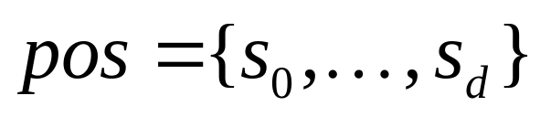
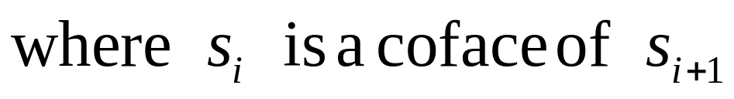
Surfing the mesh
Based on the concept of pos (position)
a pos is a d+1-tuple:
v2
e2
f
e1
v0
e0
v1
{ v0,e2,f }

Slide 20
Pos
any component of a pos can only be changed in another value to obtain another pos
v2
v2
e2
p.FlipV()
e2
f
e1
{v0,e2,f} → {v2,e2,f}
f
e1
v0
e0
v0
e0
v1
v1
v2
v2
e2
p.FlipE()
e2
f
e1
f
e1
{v0,e2,f} → {v0,e0,f}
v0
e0
v1
v0
e0
v1
f1
v2
f1
v2
e2
e2
f
e1
p.FlipF()
f
e1
v0
{v0,e2,f} → {v2,e2,f1}
v0
e0
v1
e0
v1

Slide 21
Pos
Example: running over the faces around a vertex
template <typename FaceType>
class Pos {
...
void NextE()
{
assert( f->V(z)==v || f->V((z+1)%3)==v );
FlipE();
FlipF();
assert( f->V(z)==v || f->V((z+1)%3)==v );
}
...
};
<vcg/simplex/face/pos.h>
v2
v2
v2
e2
p.FlipE()
e2
p.FlipF()
e2
f
e1
f
e1
f
e1
v0
e0
v0
e0
v0
e0
f2
v1
f2
v1
f2
v1

Slide 22
Pos Implementation
Three pointers to face and three integers in each face:
f.FFp(1)==&f1
f.FFi(1) == 2
f.FFp(2) == &f2
f.FFi(2) == 1
f.FFp(0) == &f
f.FFi(0) == -1
If it is manifold along the edge “i”:
f.FFp(i)->f.FFp(f.FFi(i)) == &f
v2
v2
v1
v0
v2
f1
f2
2
f
2
1
v1
v0
v0
0
v1
border

Slide 23
Pos: non manifoldness
Pos works also for non manifold meshes
If an edge is non manifold,
then for some face adjacent to it:
f.FFp(i)->f.FFp(f.FFi(i)) != &f

Slide 24
Pos: example
One ring neighborood
#include <vcg/simplex/vertexplus/base.h>
#include <vcg/simplex/faceplus/base.h>
#include <vcg/simplex/face/pos.h>
#include <vcg/complex/trimesh/base.h>
class MyEdge;
class MyEdge;
class MyVertex: public VertexSimp2<MyVertex,MyEdge,MyFace,vert::Coord3f>{};
class MyFace : public Face<MyVertex,MyEdge,MyFace,face::VertexRef,face::FFAdj>{};
class MyMesh : public tri::TriMesh< vector<MyVertex>, vector<MyFace > >{};
MyMesh mesh;
void ring(FaceType * f){
Pos<MyMesh::FaceType> p(f,f->V(0),0);
for(;p.F()!= f;p.NextE()){
//do something with p; }
}

Slide 25
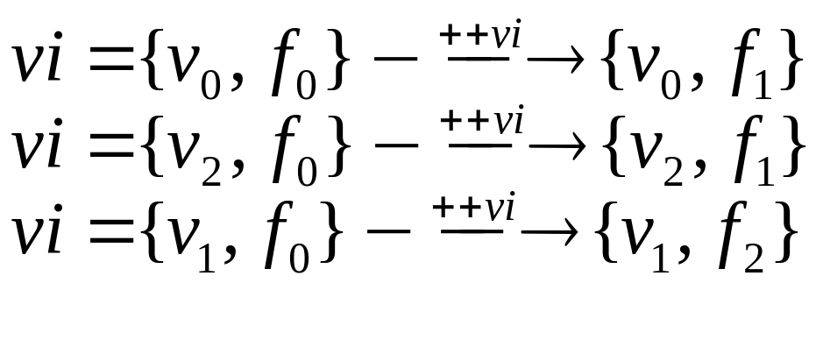
VFIterator
Used to run through the list of faces sharing a vertex
A VFIterator is a couple:
3 possible VFIterator for each face
$VFIterator=\left\{s_{0},s_{k}\right\}$
$v_{2}$
$f_{3}$
$f_{1}$
$f_{0}$
$v_{0}$
$v_{1}$
$f_{2}$

Slide 26
VFIterator
The vertex holds a pointer to one of the adjacent the face
The face holds, for each of its tree vertices, a pointer to the next face on the respective lists
v.VFp() ==&f
v.VFi() == 0;
f.VFp(0)==&f2
f.VFi(1) == 2
f2.VFp(2) == &f2
f2.VFi(2) == 1
f1.VFp(1) == null
f1.VFi(1) == -1
f
v
v0
v1
null
v2
f1
f2

Slide 27
VFIterator: example
One ring neighborood
#include <vcg/simplex/vertexplus/base.h>
#include <vcg/simplex/faceplus/base.h>
#include <vcg/simplex/face/pos.h>
#include <vcg/complex/trimesh/base.h>
class MyEdge;
class MyEdge;
class MyVertex: public VertexSimp2<MyVertex,MyEdge,MyFace,vert::Coord3f,vert::VFAdj>{};
class MyFace : public Face<MyVertex,MyEdge,MyFace,face::VertexRef,face::VFAdj>{};
class MyMesh : public tri::TriMesh< vector<MyVertex>, vector<MyFace > >{};
MyMesh mesh;
void ring(MyMesh::VertexType * v){
VFIterator<MyMesh::FaceType> vi(v);
for(;!=vi.End();++vi){
//do something with p; }
}

Slide 28
Manifoldness
A trimesh is not manifold iff:
There are more than 2
faces sharing the same edge
OR
The number of faces adjacent to
a vertex counted by running a
pos around the vertex are less
then running with a VFIterator

Slide 29
Basic Algorithms
vcg
complex
trimesh
Algorithms that create a mesh:
  Marching cubes
  by refinement from platonic shapes
  Ball Pivoting
  Subset from another mesh
  resampling…
create
Algorithms that update attributes
  FFAdjacency
  VFAdjacency
  Bounding Box
  Normals per face
  Normals per vertex
  …….
update

Slide 30
Wrap
root
wrap
gl
Render vcg objects with OpenGl
Import from (export to) fome formats:
export(import)_3ds
export(import)_dae
export(import)_dxf
export(import)_iv
export(import)_obj
export(import)_off
export(import)_ply
export(import)_smf
export(import)_stl
export(import)_vrml
export(import)_raw
…..
gui
io_trimesh
…..

Slide 31
Comparison to OpenMesh
 | OpenMesh | VCG
Data structure | Half edge | Indexed with adjacencies
Memory (bytes per vertex) | 84 | 24 face-vert + 32 face-face + 36 vert-face
generality | General for polygonal meshes | General for simplicial complexes
Access to items | Handle() | pointer
Non manifoldness | Only at vertices | complete

Slide 32
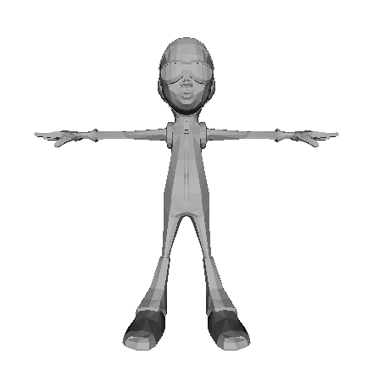
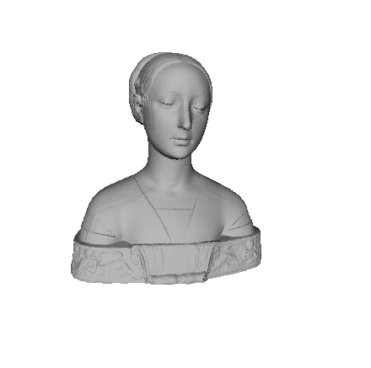
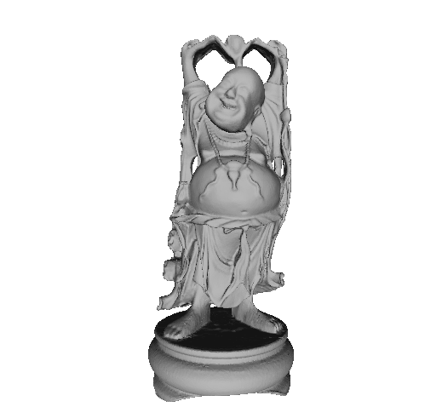
Comparison to OpenMesh
Test: iterate over all the faces of a triangle mesh. For each face read position and normal.
Time do to 1000 test (ms)
Vert / tri | VCG | OpenMesh
2619 4881 | 146 | 707
27861 49954 | 2188 | 8113
543652 1087716 | 47362 | 222177

Slide 33
Comparison to OpenMesh
Test: iterate over all the vertices of a triangle mesh. For each vertex read position and normal.
Time do to 1000 test (ms)
Vert / tri | VCG | OpenMesh
2619 4881 | 21 | 60
27861 49954 | 405 | 699
543652 1087716 | 8050 | 14425

Slide 34
Comparison to OpenMesh
Test: iterate over all the vertices of a triangle mesh. For each vertex read position and normal of all the vertices in the ring.
Time do to 100 test (ms)
Vert / tri | VCG | OpenMesh
2619 4881 | 88 | 58
27861 49954 | 913 | 590
543652 1087716 | 19600 | 12812

Slide 35
Comparison to OpenMesh
Test: iterate over all the vertices of a triangle mesh. For each vertex find all the faces connected to it. For each face read position and normal of its 3 vertices
Time do to 100 test (ms)
Vert / tri | VCG | OpenMesh
2619 4881 | 121 | 217
27861 49954 | 1226 | 2194
543652 1087716 | 26787 | 47856

Slide 36
Comparison to OpenMesh
Decimation by edge collapse with quadric error
Vert / tri | reduce to # face | VCG | OpenMesh
2619 4881 | 400 | 94 | 211
27861 49954 | 10000 | 547 | 2710
543652 1087716 | 100000 | 16578 | 1m13s

